Slide 1
Principles of ux dESIGN
Mariyana Mileva, CB01

Slide 2
What are the principles
The principle of Least Effort
The principle of Perpetual Habit
The principle of Socialization
The principle of Emotional Contagion
The principle of Identity
The principle of Beauty
The Magical Number 7, Plus or Minus Two
The principle of Mistakes
Focus, Attention and Concentration

Slide 3
The principle of Least Effort

Slide 4
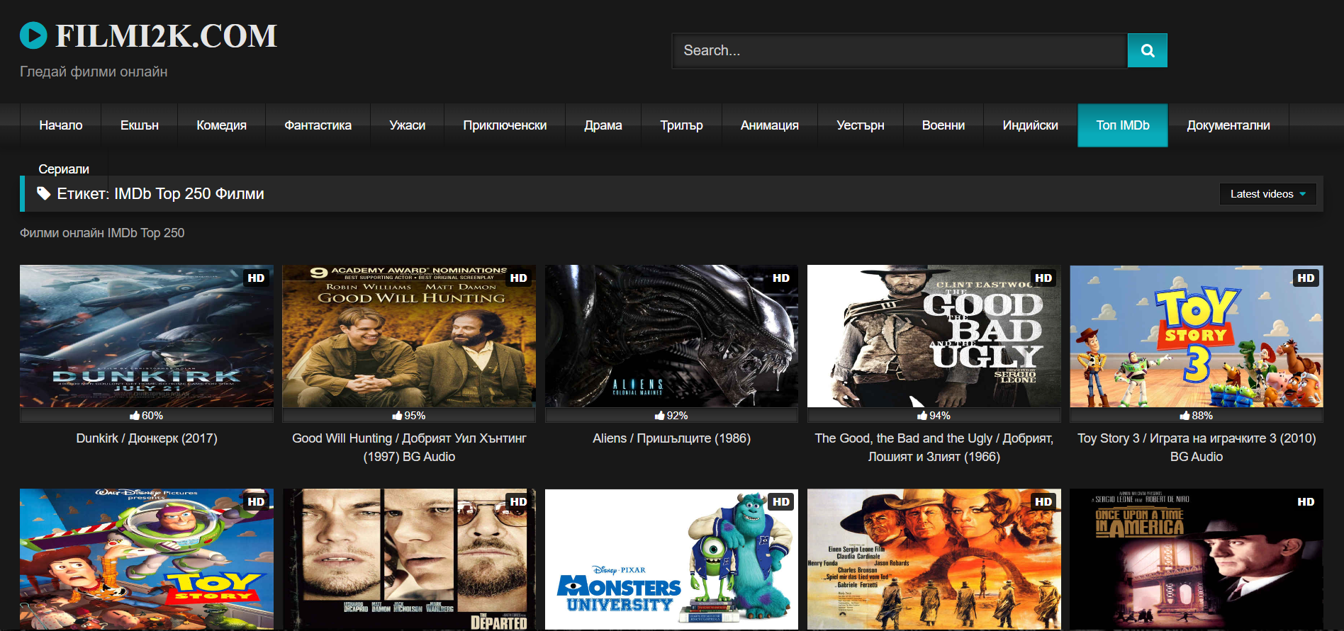
Example: filmi2k.com
The website provides brief and informative descriptions of its films.
The categories are already displayed at the top.
If a user wants to watch a movie, they simply click on the movie.

Slide 5
The principle of sOCIALIZATION

Slide 6
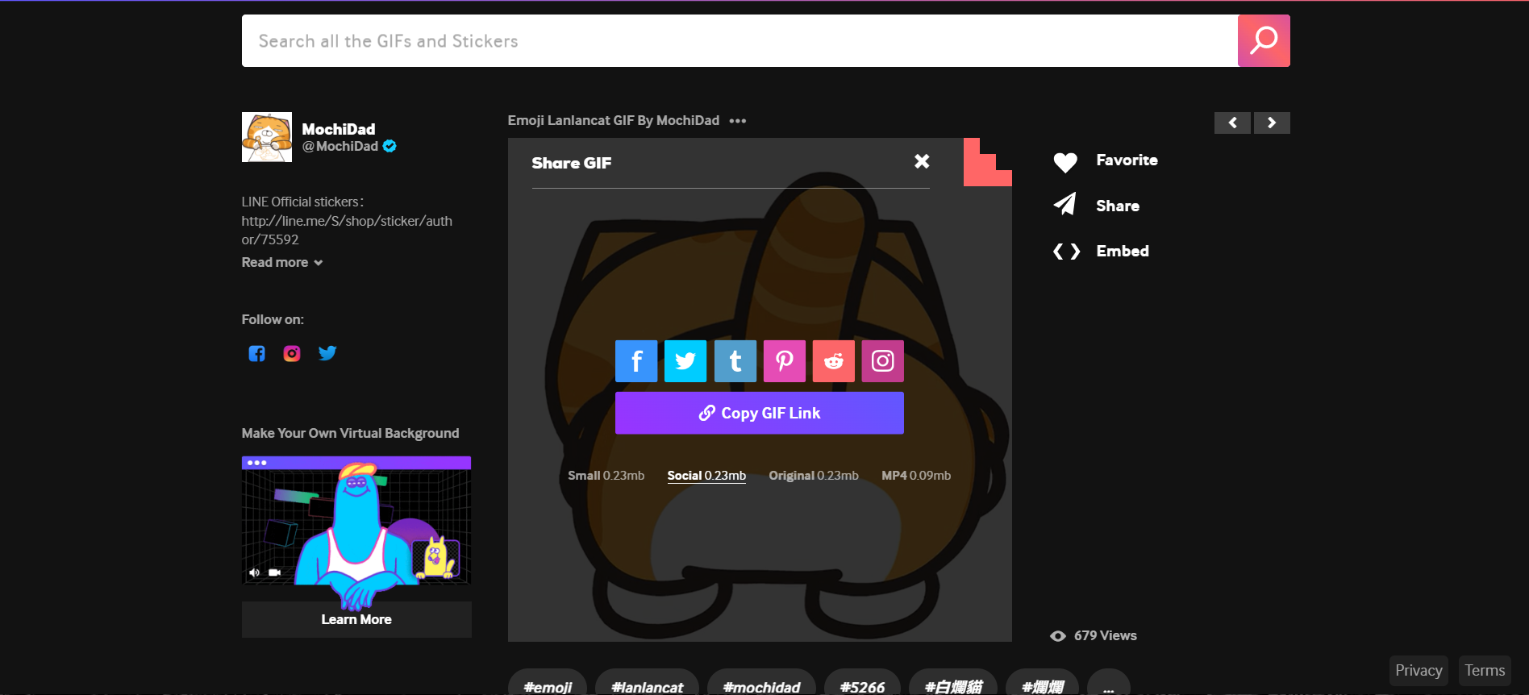
Example: Giphy.com
This website has implemented buttons for users to share their work on different social medias.

Slide 7
The principle of Emotional contaigion

Slide 8
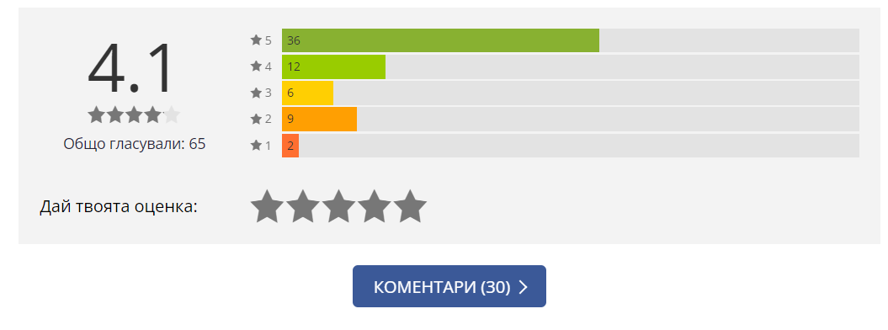
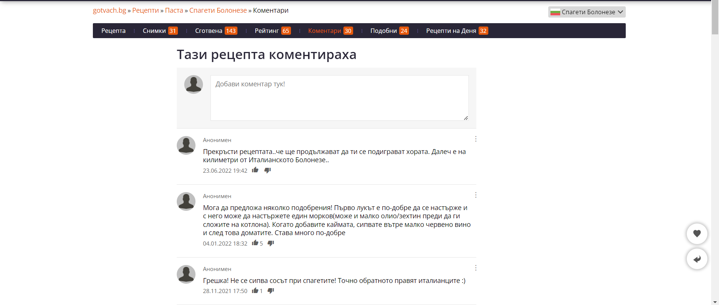
Example: GOTVACH.com
This website has implemented a comments section and ratings for the different recipes.

Slide 9
The principle of identity

Slide 10
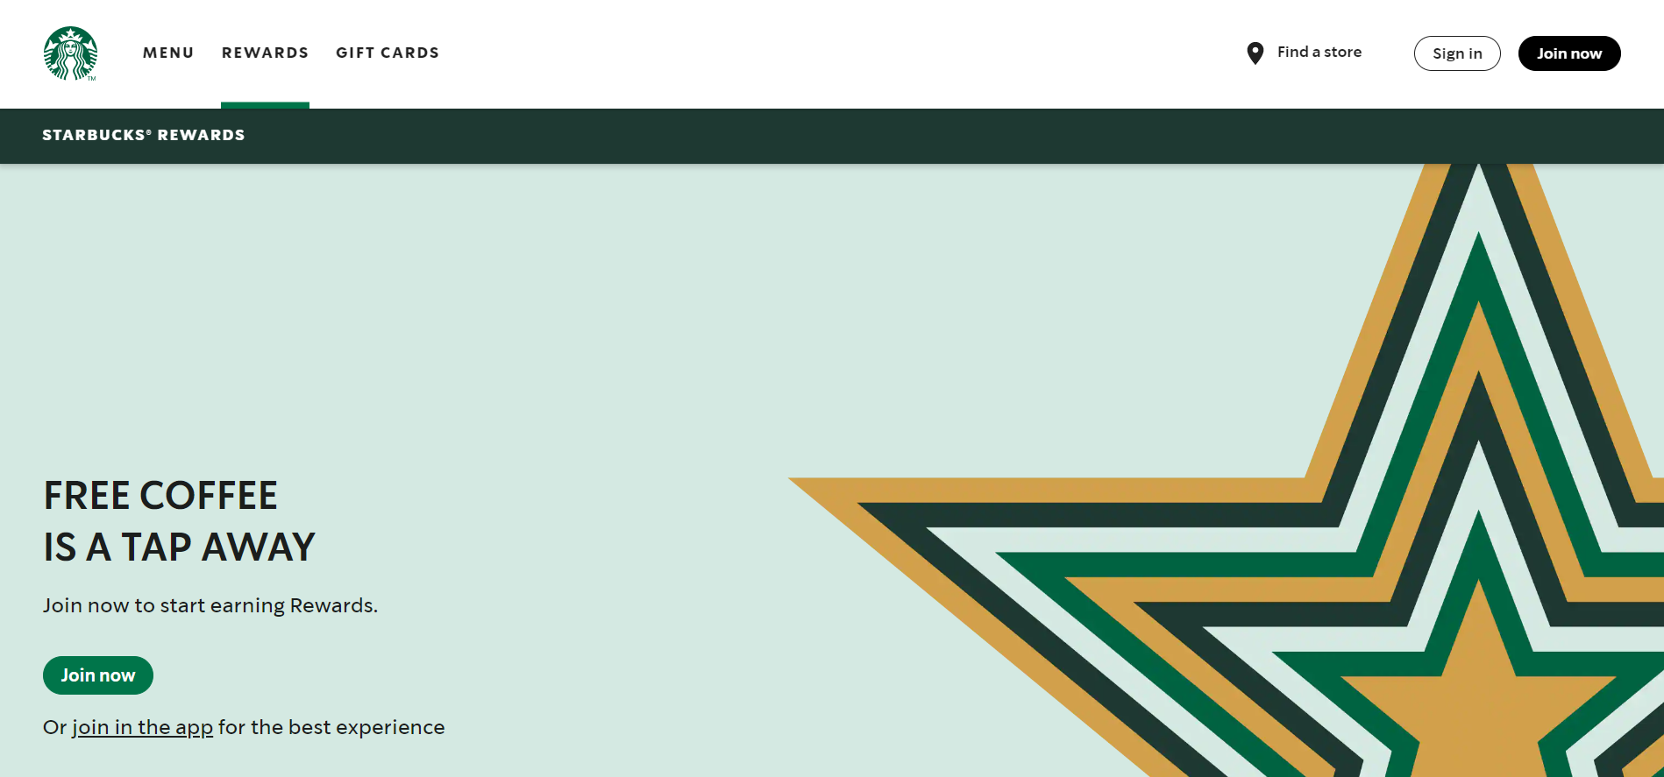
Example: sTARBUCKS.com
Starbucks has established the green color as their color
They have a unique logo

Slide 11
The principle of Beauty

Slide 12
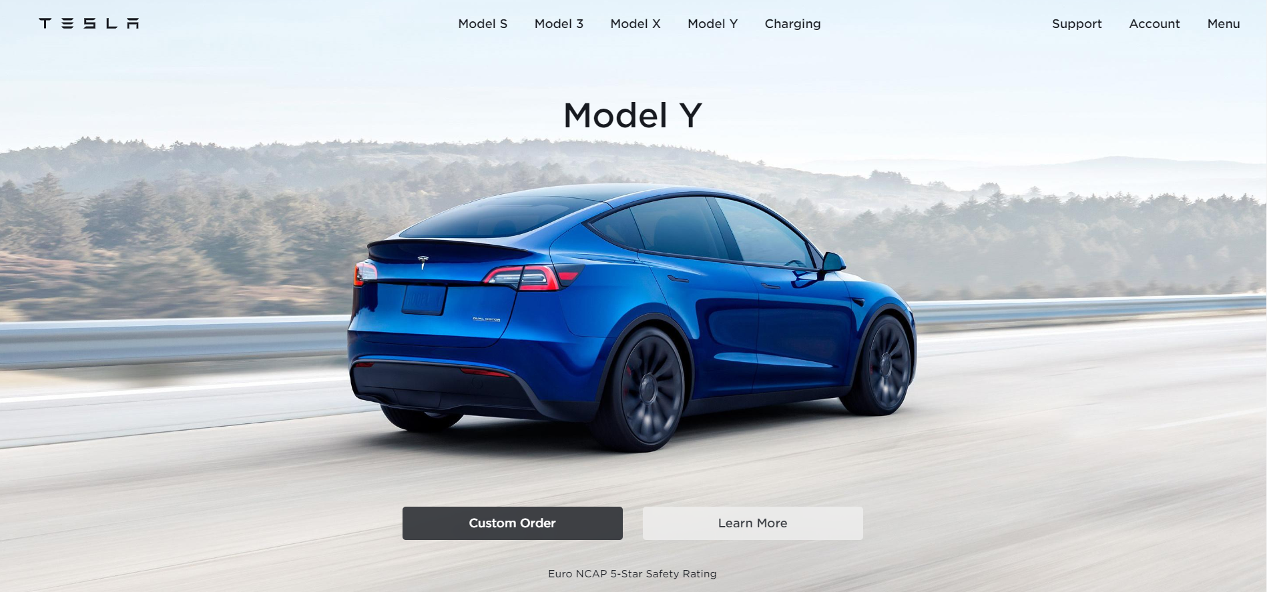
Example: Tesla.com
Tesla’s website has a clean design
They stick to one color pallete and font
They stick to modern looking design

Slide 13
The principle of Mistakes

Slide 14
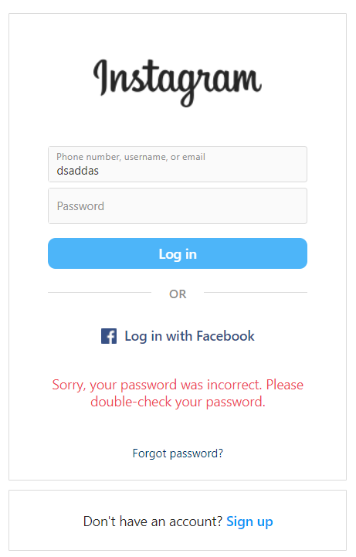
Example: instagram.com
The login page of Instagram let the user know if their password is wrong, the email or both.
They make sure the user will not be confused with what their mistake is.

Slide 15
Focus, attention & concentration

Slide 16
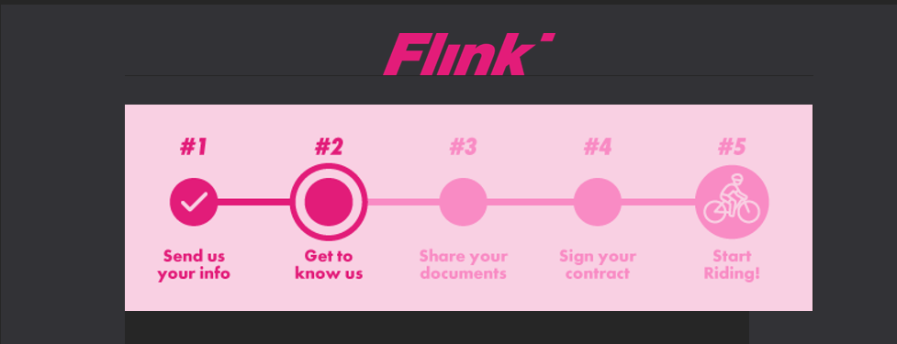
Example: GOFLINK.com
Throughout the whole process for applying for a job at flink, the users can see the steps they have already done and those that are about to be made

Slide 17
THANK YOU!

